Slide 1
Product Helpfulness Detection using BERT and LSTM

Slide 2
Team No - 15
GUIDE - Ms. T. Sri Lakshmi (Assistant Professor)
Team Members:
1. Bala Nireekshan (21501A0512)
2. Akurathi Harsha Vardhan (21501A0503)
3. Chagantipati Kavya Sri (22505A0501)
4. Gopidesi Sai Ramya Sree (21501A0556)

Slide 3
INDEX
Problem Statement
Objectives
Literature Survey
Scope
Requirement Analysis
Proposed Design
Architecture
Algorithms
Ouput Screenshots
Conclusion
Future Scope

Slide 4
ABSTRACT
In the realm of sentiment analysis for product reviews, determining the helpfulness of reviews is crucial for consumers and businesses alike. This study proposes a novel approach combining LSTM (Long Short-Term Memory) networks and BERT (Bidirectional Encoder Representations from Transformers) embeddings to enhance the accuracy of product helpfulness detection. Unlike traditional methods such as Random Forest (RF), Decision Trees (DT), LightGBM (LGB), and K-Nearest Neighbors (KNN), which are commonly used for sentiment analysis, LSTM and BERT offer advanced capabilities in capturing semantic context and contextual embeddings from textual data. The proposed system focuses on classifying reviews into three categories: positive, negative, and neutral, based on fine food reviews. Key features include leveraging LSTM for sequence modeling and BERT for fine-tuning contextual embeddings. Additionally, class probability features are extracted to provide insights into the confidence levels of predictions. Experimental results demonstrate that the LSTM-BERT hybrid model outperforms traditional methods in accuracy and robustness, making it suitable for real-world applications in e-commerce and customer feedback analysis.

Slide 5
PROBLEM STATEMENT
The primary challenge addressed in this project is the accurate classification of fine food reviews into categories of positive, negative, and neutral based on their perceived helpfulness. Existing methods like RF, DT, LGB, and KN typically struggle with capturing contextual nuances and temporal dependencies in text, leading to suboptimal performance in sentiment analysis tasks, especially over longer reviews. Additionally, accurately determining the helpfulness of reviews requires robust models that can handle the complexities of natural language and provide interpretable results.

Slide 6
SOLUTION
Use of Transformer Models: Leverage transformer-based models like BERT which are designed to capture contextual nuances and dependencies in text. These models can handle long reviews effectively when fine-tuned on sentiment analysis tasks.
Incorporate Transfer Learning: Utilize pre-trained models on large-scale datasets (like BERT) and fine-tune them on the specific dataset of fine food reviews. This approach improves performance on domain-specific tasks without requiring massive amounts of training data.
Ensemble Methods: Combine predictions from models (e.g., BERT and LSTM) with transformer-based models to improve robustness and accuracy.

Slide 7
OBJECTIVES
Develop a High-Performance Sentiment Classifier: Build a sentiment analysis model that outperforms traditional methods (RF, DT, LGB, KN) by effectively capturing contextual and temporal nuances.
Optimize for Long Reviews: Address the challenges posed by long reviews by leveraging transformer architectures capable of handling complex dependencies in text.
Ensure Interpretability: Provide interpretable results to help stakeholders understand the reasoning behind the classification of reviews.
Enhance Model Robustness: Use ensemble methods and additional features to create a robust model capable of generalizing across various review lengths and styles.
Deploy the Model: Design the solution for easy integration into platforms that host fine food reviews, ensuring scalability and real-time classification.

Slide 8
LITERATURE SURVEY
S.No | Year | Author(s) | Title | Outcomes
3 | 2022 | Xue Mengge, Tao Gui, Qi Zhang, Xuanjing Huang | BERT Post-Training for Review Reading Comprehension and Aspect-Based Sentiment Analysis | Explores finetuning BERT for aspect-based sentiment analysis, effective in capturing sentiment nuances.
1 | 2018 | Jacob Devlin, MingWei Chang, Kenton Lee, Kristina Toutanova | BERT: Pretraining of Deep Bidirectional Transformers for Language Understanding | Introduces BERT, discusses architecture, pretraining objectives, and finetuning strategies for NLP tasks.
5 | 2019 | M. Shoaib, M. T. Mahmood, S. Imran | Sentiment Analysis: Capturing Favorability Using Natural Language Processing | Reviews sentiment analysis techniques, focuses on sentiment polarity classification.
4 | 2012 | Bing Liu | A Survey on Sentiment Analysis in Social Media | Provides an overview of sentiment analysis techniques, including machine learning and deep learning approaches.
2 | 1997 | Sepp Hochreiter, Jürgen Schmidhuber | Long Short-Term Memory | Introduces LSTM networks, discusses architecture, learning mechanisms, and applications in sequence modeling.

Slide 9
SCOPE &MOTIVATION
The motivation behind this project stems from the increasing reliance on online reviews for making informed purchasing decisions. In the realm of e-commerce, particularly in the fine food sector, consumers heavily depend on reviews to assess product quality, taste, and overall satisfaction. However, the sheer volume of reviews and their varying degrees of helpfulness pose a challenge in extracting meaningful insights. Traditional sentiment analysis methods often fall short in accurately capturing the nuanced sentiments and perceived helpfulness of reviews, necessitating more advanced approaches.

Slide 10
HARDWARE AND SOFTWARE REQUIREMENTS
H/W Configuration:
Operating system : Windows 7 or 7+
RAM : 8 GB
Hard disc or SSD : More than 500 GB
Processor : Intel 3rd generation or high or Ryzen with 8 GB Ram
S/W Configuration:
Software’s : Python 3.6 or high version
IDE : VSCode.
Framework : Flask

Slide 11
Existing System:
Current sentiment analysis systems often rely on traditional machine learning algorithms such as Random Forest, Decision Trees, LightGBM, and K-Nearest Neighbors for classifying sentiment in product reviews. These methods typically struggle with capturing complex contextual meanings and long-range dependencies in text. They often require extensive feature engineering and may not adapt well to varying linguistic styles and nuances in reviews. Interpretability of results can also be challenging.
Disadvantages:
1. Limited Contextual Understanding: Traditional methods may fail to capture subtle nuances and contextual meanings embedded in lengthy reviews.
2. Dependency on Feature Engineering: They often rely heavily on manual feature engineering, which can be time-consuming and may not generalize well.
3. Difficulty in Scalability: Scaling these models to handle large datasets efficiently can be challenging due to computational limitations and model complexity.

Slide 12
Proposed Design:
The proposed system integrates LSTM networks and BERT embeddings to enhance sentiment analysis accuracy in fine food reviews. LSTM models temporal dependencies, while BERT provides rich contextual embeddings, enabling better understanding of review semantics. This hybrid approach aims to improve classification accuracy and provide more nuanced insights into review helpfulness.
Advantages:
1. Enhanced Semantic Understanding: LSTM-BERT hybrid model captures intricate contextual meanings and temporal dependencies in reviews.
2. Reduced Dependency on Feature Engineering: BERT embeddings reduce the need for extensive manual feature engineering.
3. Improved Accuracy and Interpretability: The model offers higher accuracy in sentiment classification and provides transparent insights into review helpfulness based on class probability features.

Slide 13
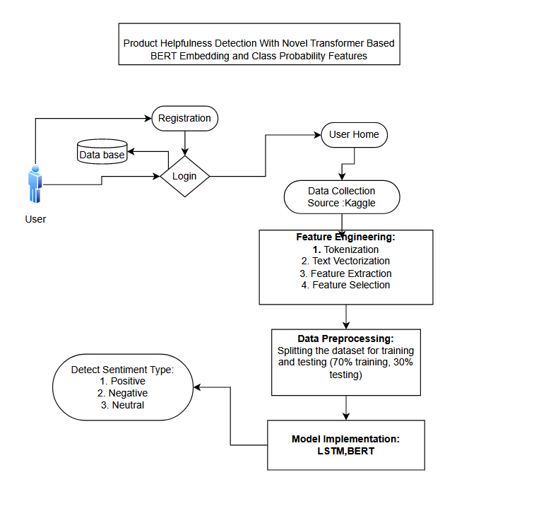
METHODOLOGY:

Slide 14
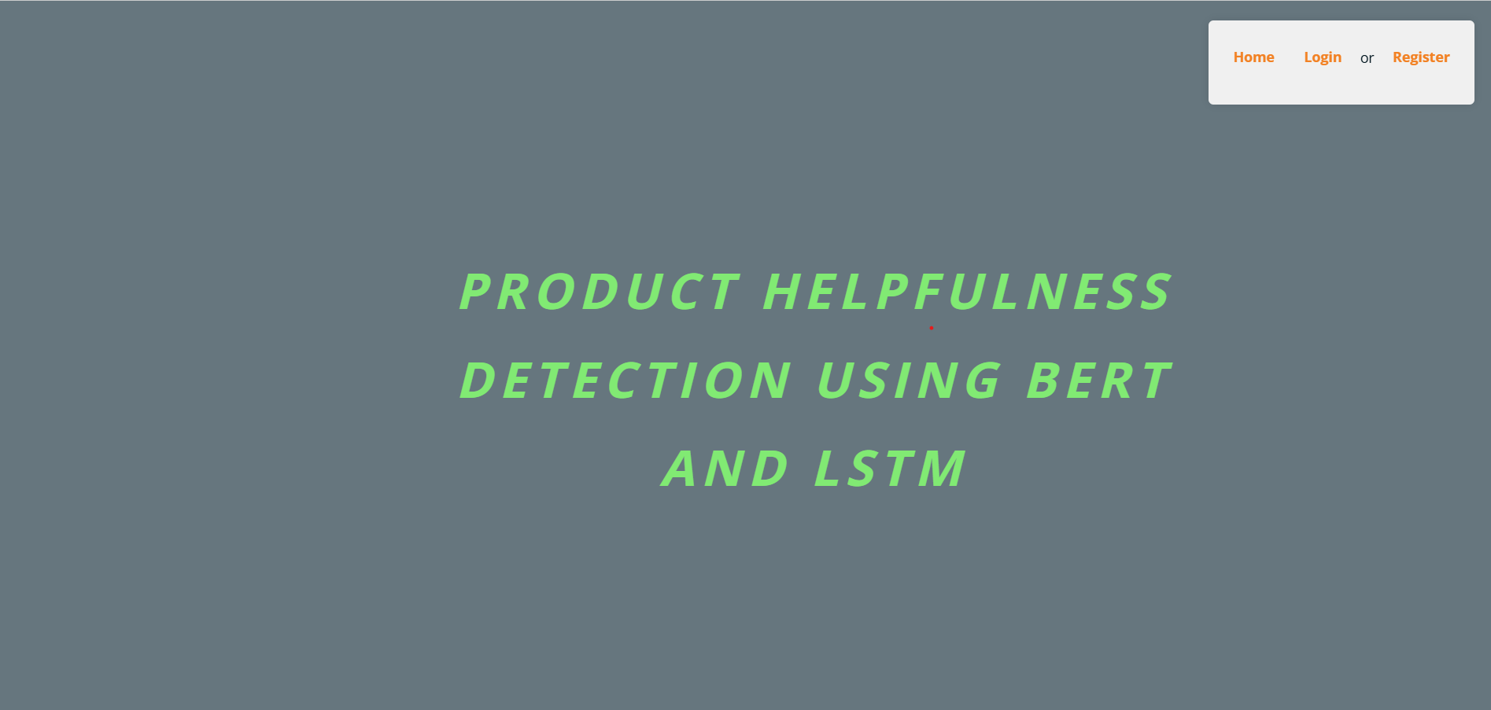
Home: Welcome to Sentiment analysis website application

Slide 15
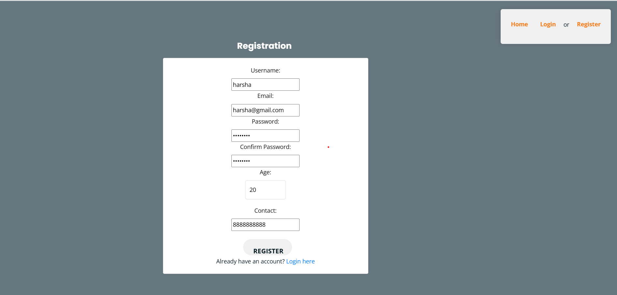
Register: The registration page enables new users to create an account.

Slide 16
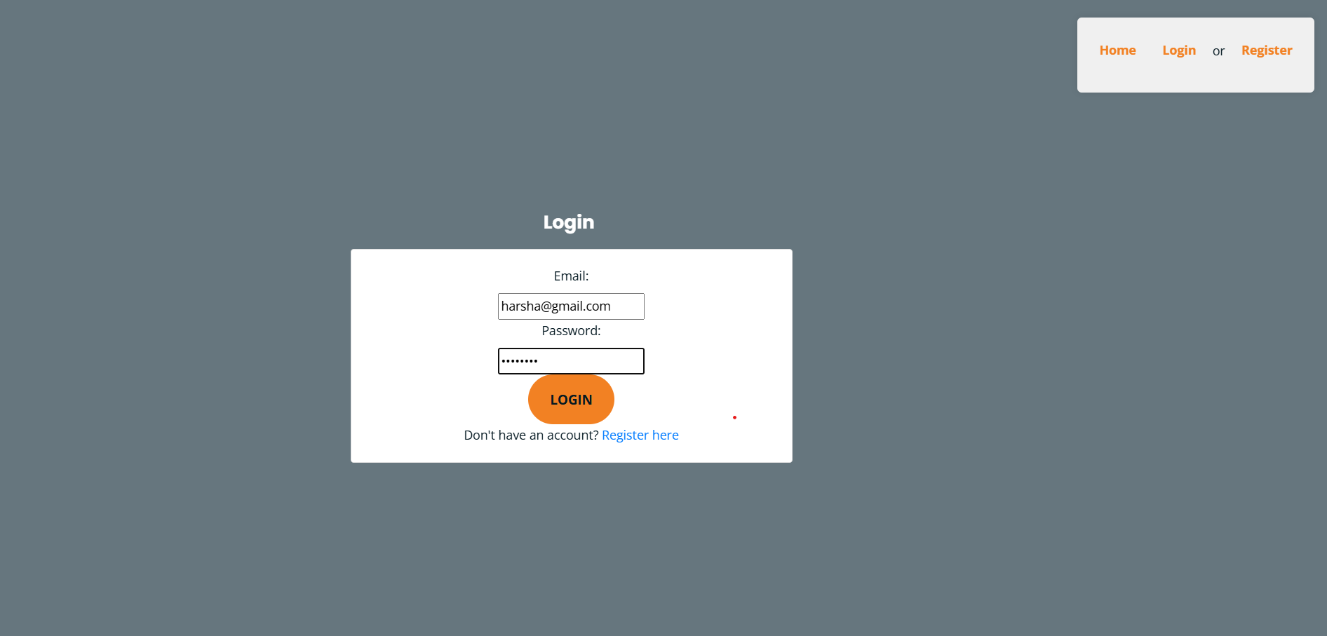
Login: The login page allows registered users to securely access the application.

Slide 17
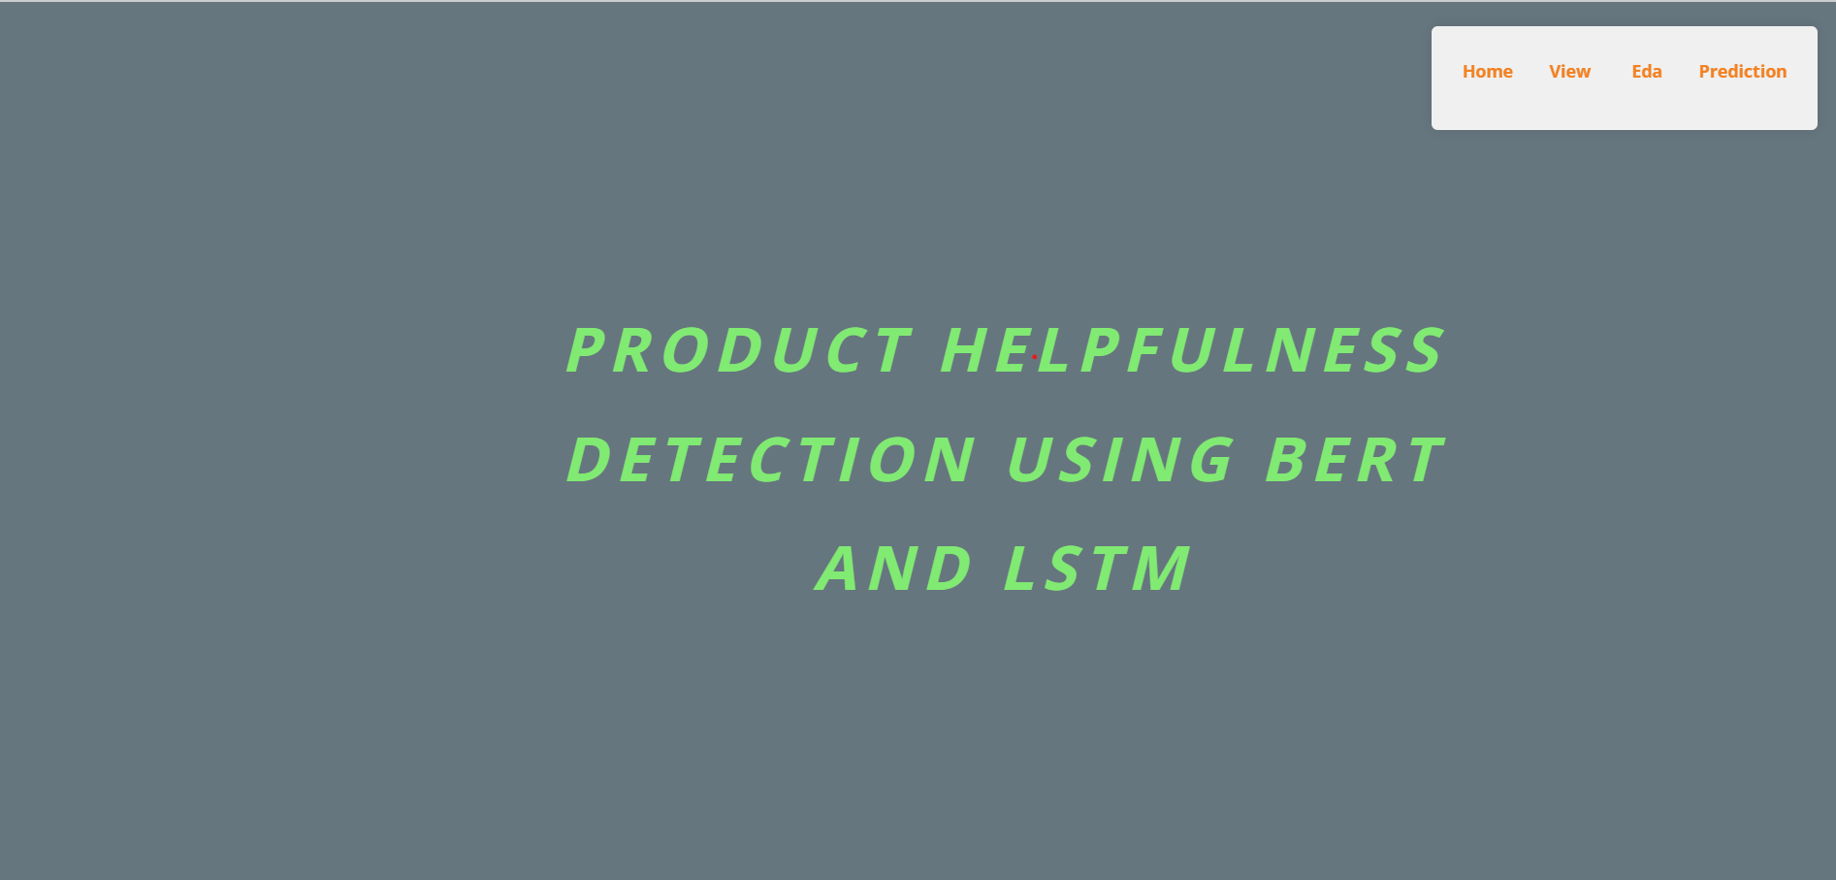
User home: Welcome to Sentiment Analysis website application

Slide 18
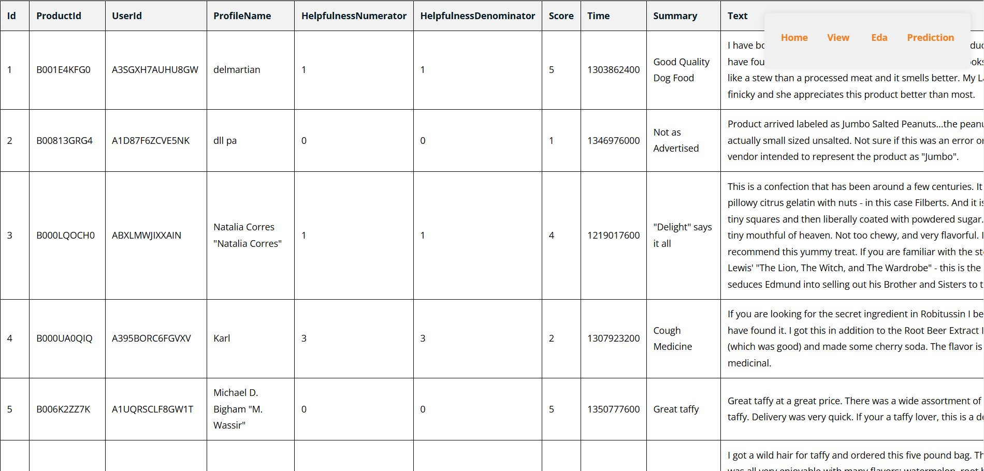
View: The view data page provides users with access to the data used for sentiment analysis.

Slide 19
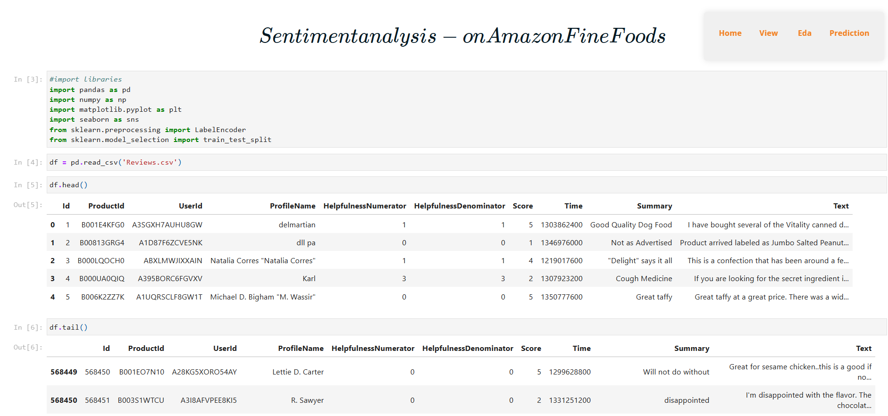
Eda: This page shows that data analysis of the dataset.

Slide 20
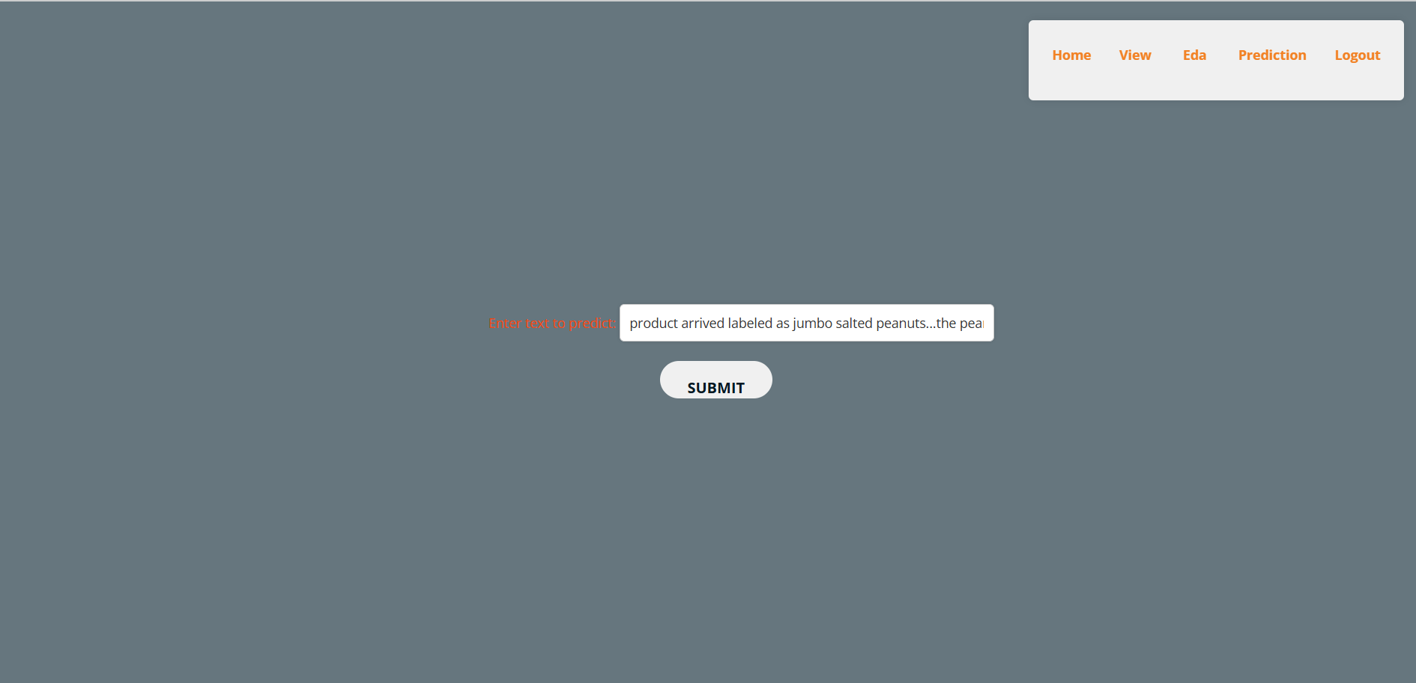
Prediction : The prediction page allows users to utilize the trained models to detect sentiment type of the texts.

Slide 21
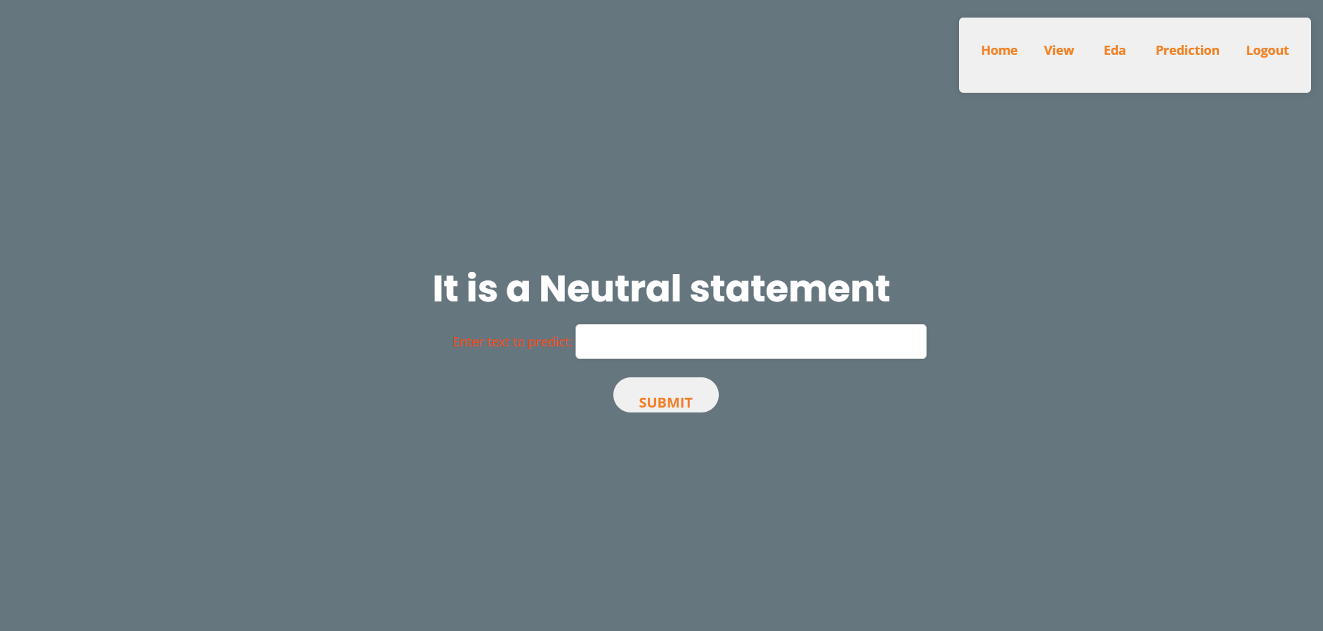
Neutral : Neutral sentiment refers to a statement or text that neither conveys positive nor negative emotions. It is impartial and objective, lacking strong feelings or opinions.
Statement : if you are looking for the secret ingredient in robitussin i believe i have found it. i got this in addition to the root beer extract i ordered (which was good) and made some cherry soda. the flavor is very medicinal.

Slide 22

Positive: Positive sentiment refers to the expression of favorable or optimistic emotions in text. When a statement is classified as positive, it conveys happiness, satisfaction, appreciation, or an overall positive outlook.
Statement : i have bought several of the vitality canned dog food products and have found them all to be of good quality. the product looks more like a stew than a processed meat and it smells better. my labrador is finicky and she appreciates this product better than most.

Slide 23

Negative: Negative sentiment refers to expressions of unfavorable, disagreeable, or adverse feelings and attitudes in a piece of text. This type of sentiment typically conveys emotions such as sadness, anger, frustration, disappointment, or criticism.
Statement : the candy is just red , no flavor . just plan and chewy . i would never buy them again

Slide 24
CONCLUSION:
The proposed hybrid system combining LSTM and BERT aims to harness the strengths of both approaches: LSTM for sequence modeling and capturing temporal dependencies, and BERT for contextual understanding and semantic representation. This hybrid approach not only enhances the accuracy and efficiency of sentiment analysis in fine food reviews but also provides insights into the perceived helpfulness of reviews based on class probability features derived from the model. In essence, while traditional methods laid the groundwork for sentiment analysis, the advent of deep learning models like LSTM and BERT has paved the way for more sophisticated and accurate sentiment analysis systems. Future advancements will likely continue to build upon these foundations, further refining models to better understand and interpret human sentiments expressed in textual data across various domains and applications.

Slide 25
FUTURE SCOPE
In the future, enhancements to sentiment analysis and review classification systems could focus on several key areas to further improve accuracy, efficiency, and applicability across diverse domains. Firstly, integrating multimodal inputs such as images, audio, and video along with textual data could provide a more comprehensive understanding of sentiment, especially in reviews where users might express emotions through different modalities.Secondly, advancements in transfer learning techniques tailored specifically for sentiment analysis could streamline model adaptation to new domains with minimal data requirements. Techniques like domain adaptation and meta-learning could facilitate better generalization and performance on niche datasets or evolving domains.Moreover, enhancing model interpretability and transparency remains crucial, enabling users to understand how decisions are made and increasing trust in automated sentiment analysis systems. Techniques such as attention mechanisms and explainable AI approaches could shed light on which parts of reviews contribute most to sentiment predictions.Lastly, leveraging advancements in natural language generation (NLG) to provide meaningful summaries or contextually appropriate responses to reviews could enhance user interaction and utility of sentiment analysis systems in real-world applications. These advancements collectively aim to advance the state-of-the-art in sentiment analysis, making it more robust, adaptable, and user-friendly across various domains and applications.

Slide 26


